Slide 1
Can Drug Efficacy Prediction Be Achieved Via Machine Learning?
Sai Vivek Kammari (A1807677)
University Of Adelaide
Supervisors: Mohsen Dorraki, Zhibin Liao, Johan Verjans.
Second Marker: Ehsan Abbasnejad.

Slide 2
Introduction
Drug efficacy can be defined as the maximal effect that a drug produces.
For the prediction of drug response, many studies have found that the gene expression is the most informative data.
Drug chemical properties and compositions are the other crucial information sources for predicting the drug response.
IC50 (half-maximal inhibitory concentration) is the concentration of the drug required to reduce the biological process or component by 50%.

Slide 3
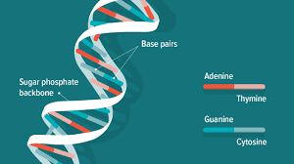
What is DNA, Gene & Genome?
Figure 1: DNA
DNA (deoxyribonucleic acid) is the basic structure in the nucleus of the cell (around 2m long).
Gene is the segment of DNA with a specific nucleotide sequence which quotes for specific protein or RNA.
Genome is all the DNA is an organism’s cell. In humans it is all the DNA present in nucleus and mitochondria.

Slide 4
Motivation
Remarkable progress has been made over the last couple of decades in the direction of cancer care and drug development
Despite of such huge developments in the cancer care, the improvement in the overall patient survival rates of some of the most common cancers is not significant. Cancer drug resistance in patients is one of the prime reasons behind such a trend
Unacceptable drug toxicity is one of the prime reasons why the drugs fail in the clinical trials or withdrawn from the market, this involves huge cost. Predicting the toxicity of a drug in the pre-clinical set up will save a lot of time, effort and money.

Slide 5
Review Of Previous Work
Support vector machine (SVM’s) and semi supervised machine learning techniques are gaining traction in predicting the outcomes and modeling cancer survival [Biotechnology Journal, vol.]. The 2014 study also highlighted the need of research in the direction of constructing public database of cancer patients [1].
In 2018, a study used a novel deep learning model dubbed Cancer Drug Response profile scan (CDRscan) to predict the drug outcomes or response. CDRscan is an ensemble of 5 CNN’s with different architecture and functionalities. The data used in the study is, structural profiles of 244 anticancer drugs and genomic profiles of 787 human cancer cell lines[2].
A 2019 study has developed a deep neural network machine learning model dubbed as MOLI (multi-omics late integration) for the purpose of integrating gene expression data, somatic mutation, copy number aberration datasets and predicting the drug response. The study found that the MOLI predicted with more accuracy in six out of seven external validation datasets and outperformed in all the seven external validation datasets when compared with the early integration using NMF (non-negative matrix factorization) [3 ].

Slide 6
Project details
Figure 2: a) GDSC Data b) CCLE Data
Research Purpose:
To develop a machine learning model to predict drug efficacy and sensitivity
Datasets:
GDS cell lines dataset
CCLE: The Cancer Cell Line Encyclopedia Project

Slide 7
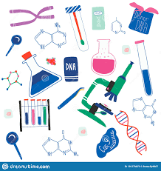
Research design
Figure 3: Research Design
mRNA
Copy Number
Mutations
Integrating Datasets
Machine Learning
Predicted
IC50
SMILES
PaDel
Drug Features

Slide 8
Data Collection & Data Integration
Datasets
GDSC: The Genomics of Drug Sensitivity in Cancer Project
CCLE: The Cancer Cell Line Encyclopedia Project
STR & SNP Profiles
Drugs Data (SMILES)
Integration Techniques
Early Integration
Late Integration

Slide 9
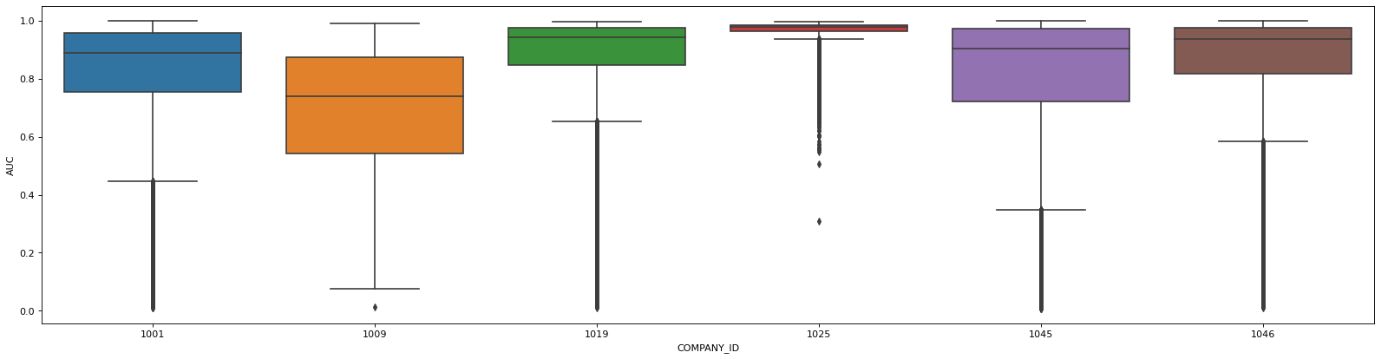
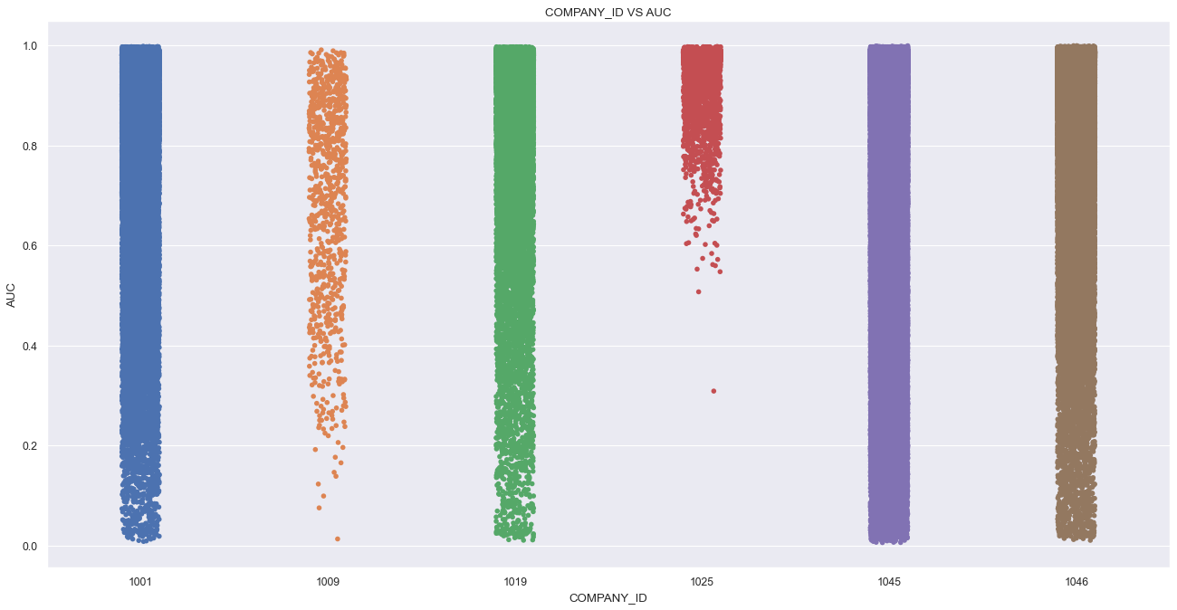
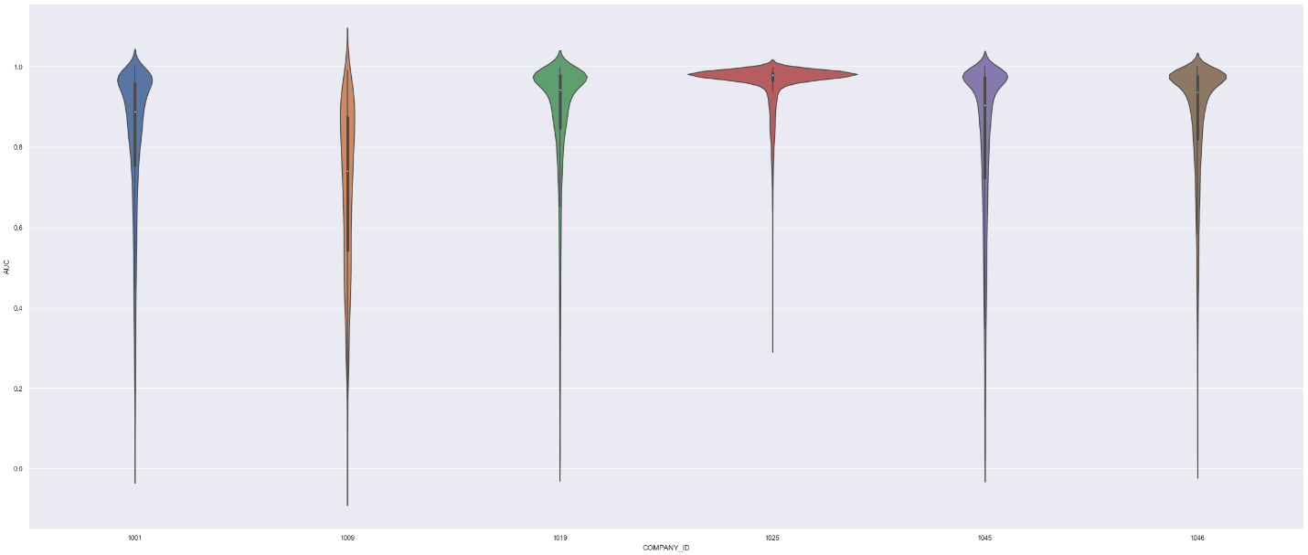
Exploratory Data Analysis: GDSC Dataset Visualization
Fig 4: AUC Boxplot of Companies
Fig 5: AUC Scatter plot of Companies
Fig 6: AUC Paino plot of Companies

Slide 10


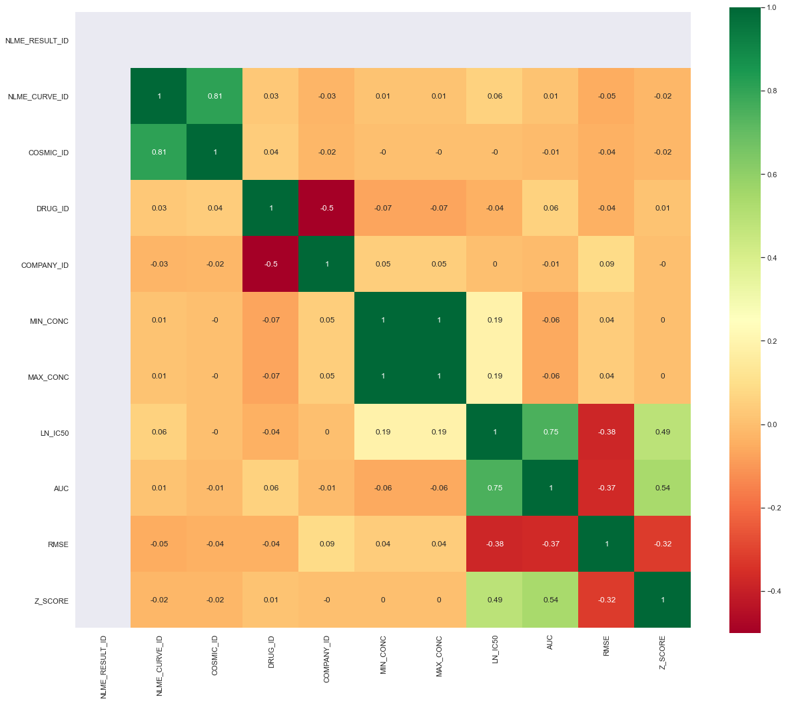
Exploratory Data Analysis GDSC Dataset Visualization
correlation matrix is a tabular data representing the ‘correlations’ between pairs of variables in a given data.

Slide 11
Data Preparation
We have conducted four different experiments in our project. The first three experiments were conducted using the GDSC dataset and the fourth experiment was conducted using the CCLE dataset.
Single Omics Dataset
Multi Omics Dataset
STR & SNP Dataset
CCLE Dataset

Slide 12
Machine Learning Models
Machine learning models implemented
XGBoost
LGB
Cat Boost
Averaged Model : Combined the predictions of XGB , Cat Boost and LGB by taking simple average.
Final Predictions = Average (XGB predictions, LGB predictions, Cat Boost predictions)
Stacking of XGB, Cat Boost and LGB : Combined the predictions of XGB and LGB using LASSO as Meta Learner.
Final Predictions = LASSO (XGB predictions, LGB predictions, Cat Boost predictions)

Slide 13
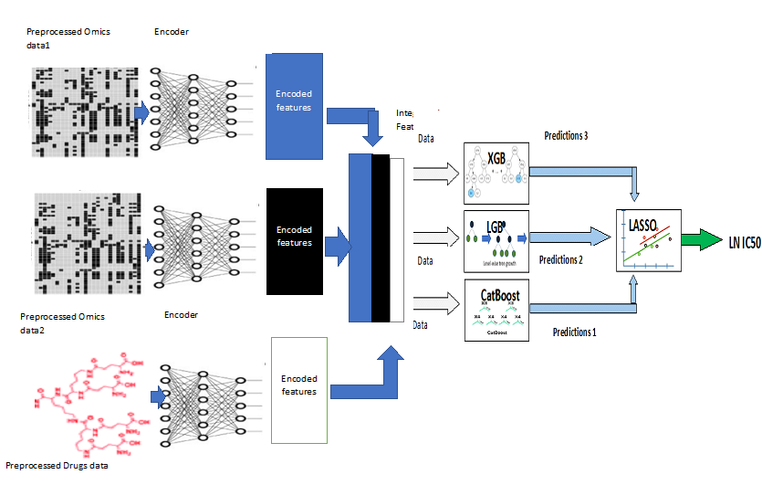
Model Architecture
Figure 7: The figure is a more granular view of the Multi omics prediction architecture.

Slide 14
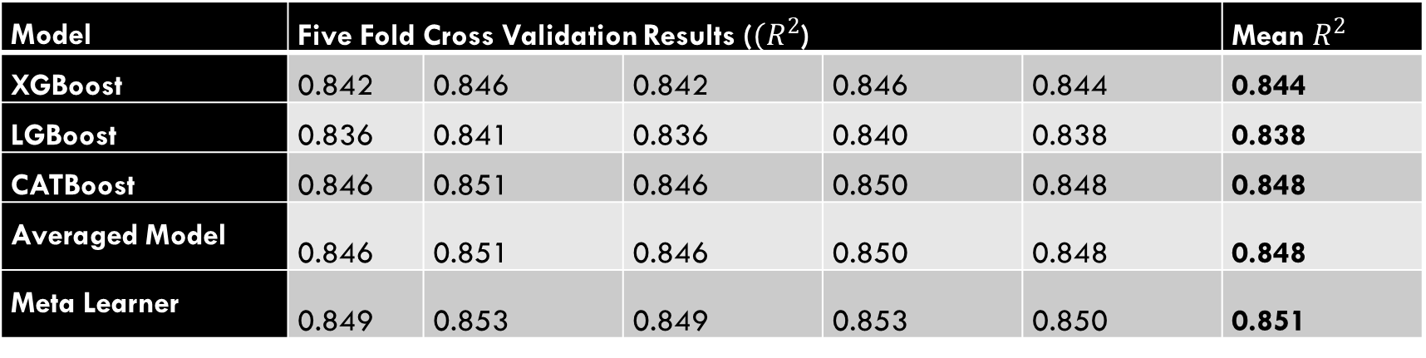
Results: Single Omics Dataset
Model | Five Fold Cross Validation Results (${(R}^{2}$) |  |  |  |  | Mean $R^{2}$
XGBoost | 0.842 | 0.846 | 0.842 | 0.846 | 0.844 | 0.844
LGBoost | 0.836 | 0.841 | 0.836 | 0.840 | 0.838 | 0.838
CATBoost | 0.846 | 0.851 | 0.846 | 0.850 | 0.848 | 0.848
Averaged Model | 0.846 | 0.851 | 0.846 | 0.850 | 0.848 | 0.848
Meta Learner | 0.849 | 0.853 | 0.849 | 0.853 | 0.850 | 0.851
Model | Five Fold Cross Validation Results (MSE) |  |  |  |  | Mean MSE
XGBoost | 1.195 | 1.161 | 1.193 | 1.178 | 1.187 | 1.183
LGBoost | 1.235 | 1.198 | 1.238 | 1.224 | 1.227 | 1.225
CATBoost | 1.160 | 1.129 | 1.163 | 1.148 | 1.156 | 1.151
Averaged Model | 1.161 | 1.127 | 1.162 | 1.148 | 1.154 | 1.151
Meta Learner | 1.141 | 1.108 | 1.138 | 1.129 | 1.135 | 1.130

Slide 15
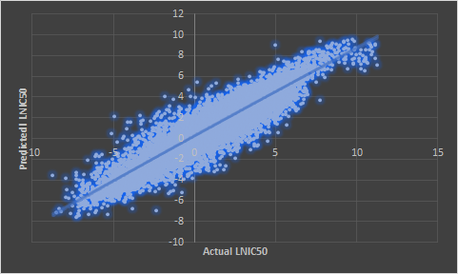
Results: Single Omics Dataset
Figure 8: LN IC50 predictions using meta learner model using single omics data.

Slide 16
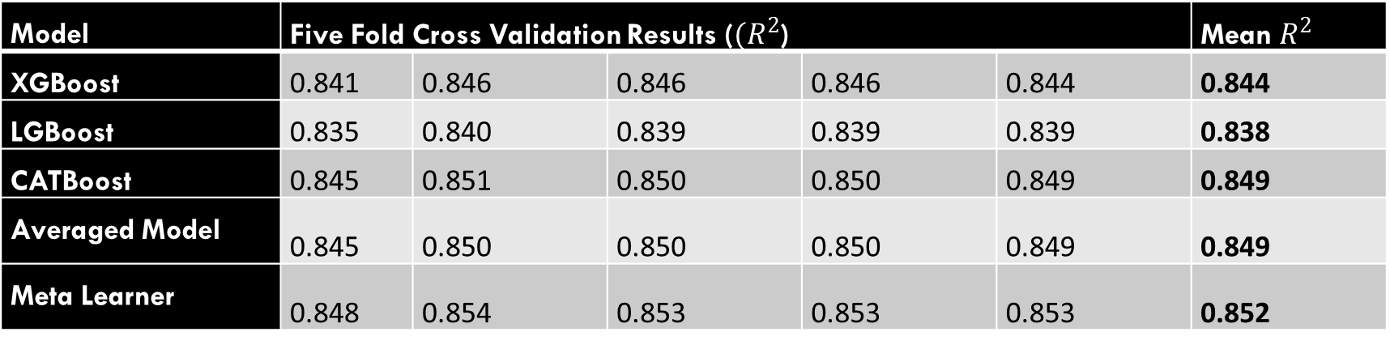
Results: Multi Omics Dataset
Model | Five Fold Cross Validation Results (${(R}^{2}$) |  |  |  |  | Mean $R^{2}$
XGBoost | 0.841 | 0.846 | 0.846 | 0.846 | 0.844 | 0.844
LGBoost | 0.835 | 0.840 | 0.839 | 0.839 | 0.839 | 0.838
CATBoost | 0.845 | 0.851 | 0.850 | 0.850 | 0.849 | 0.849
Averaged Model | 0.845 | 0.850 | 0.850 | 0.850 | 0.849 | 0.849
Meta Learner | 0.848 | 0.854 | 0.853 | 0.853 | 0.853 | 0.852
Model | Five Fold Cross Validation Results (MSE) |  |  |  |  | Mean MSE
XGBoost | 1.186 | 1.165 | 1.165 | 1.172 | 1.192 | 1.176
LGBoost | 1.231 | 1.203 | 1.222 | 1.221 | 1.233 | 1.222
CATBoost | 1.154 | 1.123 | 1.137 | 1.139 | 1.152 | 1.141
Averaged Model | 1.155 | 1.128 | 1.139 | 1.143 | 1.157 | 1.144
Meta Learner | 1.134 | 1.104 | 1.115 | 1.117 | 1.126 | 1.119

Slide 17
Results: Multi Omics Dataset
Figure 9: LN IC50 predictions using meta learner model using multi omics data.

Slide 18
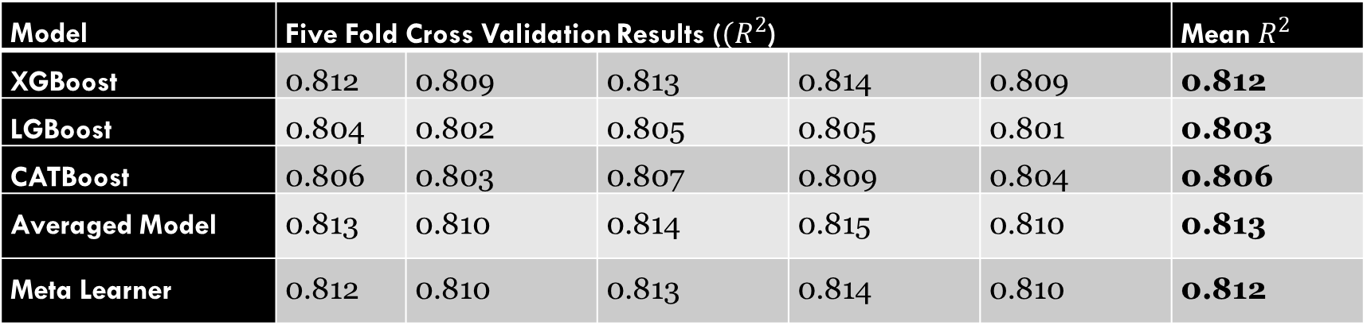
Results: STR & SNP Dataset
Model | Five Fold Cross Validation Results (${(R}^{2}$) |  |  |  |  | Mean $R^{2}$
XGBoost | 0.812 | 0.809 | 0.813 | 0.814 | 0.809 | 0.812
LGBoost | 0.804 | 0.802 | 0.805 | 0.805 | 0.801 | 0.803
CATBoost | 0.806 | 0.803 | 0.807 | 0.809 | 0.804 | 0.806
Averaged Model | 0.813 | 0.810 | 0.814 | 0.815 | 0.810 | 0.813
Meta Learner | 0.812 | 0.810 | 0.813 | 0.814 | 0.810 | 0.812
Model | Five Fold Cross Validation Results (MSE) |  |  |  |  | Mean MSE
XGBoost | 1.420 | 1.449 | 1.418 | 1.421 | 1.426 | 1.427
LGBoost | 1.478 | 1.505 | 1.483 | 1.487 | 1.491 | 1.489
CATBoost | 1.461 | 1.499 | 1.466 | 1.461 | 1.469 | 1.471
Averaged Model | 1.411 | 1.441 | 1.411 | 1.411 | 1.419 | 1.418
Meta Learner | 1.415 | 1.447 | 1.418 | 1.419 | 1.425 | 1.425

Slide 19
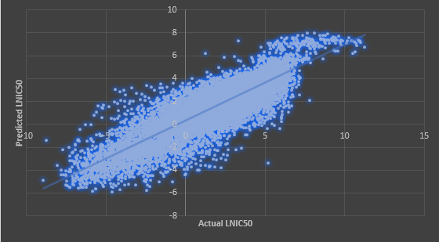
Results: STR & SNP Dataset
Figure 10 LN IC50 predictions using meta learner model using STR & SNP omics data.

Slide 20
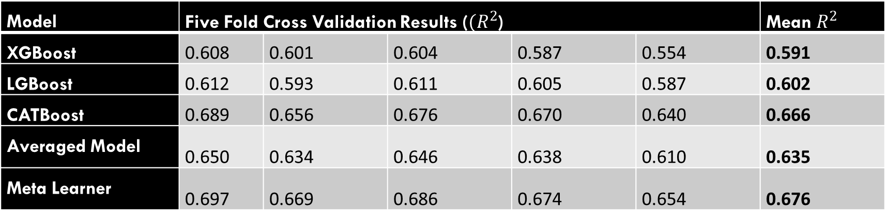
Results: CCLE Dataset
Model | Five Fold Cross Validation Results (${(R}^{2}$) |  |  |  |  | Mean $R^{2}$
XGBoost | 0.608 | 0.601 | 0.604 | 0.587 | 0.554 | 0.591
LGBoost | 0.612 | 0.593 | 0.611 | 0.605 | 0.587 | 0.602
CATBoost | 0.689 | 0.656 | 0.676 | 0.670 | 0.640 | 0.666
Averaged Model | 0.650 | 0.634 | 0.646 | 0.638 | 0.610 | 0.635
Meta Learner | 0.697 | 0.669 | 0.686 | 0.674 | 0.654 | 0.676
Model | Five Fold Cross Validation Results (MSE) |  |  |  |  | Mean MSE
XGBoost | 1.574 | 1.535 | 1.629 | 1.550 | 1.540 | 1.565
LGBoost | 1.560 | 1.567 | 1.597 | 1.481 | 1.425 | 1.526
CATBoost | 1.251 | 1.325 | 1.331 | 1.237 | 1.243 | 1.277
Averaged Model | 1.404 | 1.410 | 1.455 | 1.359 | 1.347 | 1.395
Meta Learner | 1.217 | 1.274 | 1.291 | 1.221 | 1.194 | 1.239

Slide 21
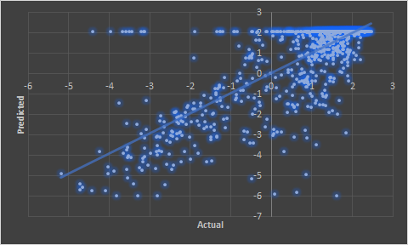
Results: CCLE Dataset
Figure 11: LN IC50 predictions using meta learner model using CCLE data.

Slide 22
Findings and conclusion
Stacked XGB, LGB and Cat Boost with LASSO meta learner outperformed all the other models explored in all the experiments.
Our experiments made it clear that the omics data present better information compared to the STR & SNP profiles of cell lines and we can achieve better predictions using the omics representation of cell line.
Furthermore; Multi omics representation of cell lines gives better predictions of efficacy compared to single omics.
In our project we have experimented using the single omics (mRNA expressions) and multi omics (mRNA expressions and copy number variations). However, the same architecture can be used for any number of omics datasets.

Slide 23
REFERENCES
[1] Kourou, K, Exarchos, TP, Exarchos, KP, Karamouzis, MV & Fotiadis, DI 2015, ‘Machine learning applications in cancer prognosis and prediction’, Computational and Structural Biotechnology Journal, vol. 13, no. C, pp. 8–17
[2] Chang, Y, Park, H, Yang, H-J, Lee, S, Lee, K-Y, Kim, TS, … Shin, J-M 2018, ‘Cancer Drug Response Profile scan (CDRscan): A Deep Learning Model That Predicts Drug Effectiveness from Cancer Genomic Signature’, Scientific Reports, vol. 8, no. 1, pp. 8857–11.
[3] Sharifi-Noghabi, H, Zolotareva, O, Collins, CC & Ester, M 2019, ‘MOLI: multi-omics late integration with deep neural networks for drug response prediction’, Bioinformatics, vol. 35, no. 14, pp. i501–i509.
[4]Yang, W. et al. (2012) Genomics of Drug Sensitivity in Cancer (GDSC): a resource for therapeutic biomarker discovery in cancer cells. Nucleic Acids Res., 41, D955–D961.
[5] Gao, H. et al. (2015) High-throughput screening using patient-derived tumor xenografts to predict clinical trial drug response. Nat. Med., 21, 1318–132
[6] Ding, M.Q. et al. (2018) Precision oncology beyond targeted therapy: combining omics data with machine learning matches the majority of cancer cells to effective therapeutics. Mol. Cancer Res., 16, 269–278.
[7] Weinstein, J.N. et al. (2013) The Cancer Genome Atlas pan-cancer analysis project. Nature Genet., 45, 1113–1120.

Slide 24

Thank you! Questions?

